Slide 1
SPO Awards
June 2023

Slide 2
Slightly Changed Award Assignment Processes
Starting on July 17, 2023

Slide 3
Current Processes
Award Notification/Assignment email sent with award document attached
Post-Award Request Assignment email sent with emailed request in email chain or attachment
Emails sent by SPO Intake Analyst Kassandra Flores

Slide 4
COMPARISON
Current Award Assignment Process
New Award Assignment Process to start July 17
SPO Intake Analyst sends each assignment email through Outlook
Award documents attached in assignment email
Assignment emails will be sent each day at 12 noon and 6 pm – automated process takes information out of Cayuse record to generate the emails
Award correspondence and actual award document uploaded into Cayuse

Slide 5
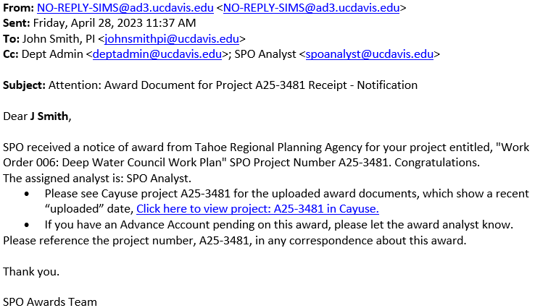
New Award Received Assignment Email

Slide 6
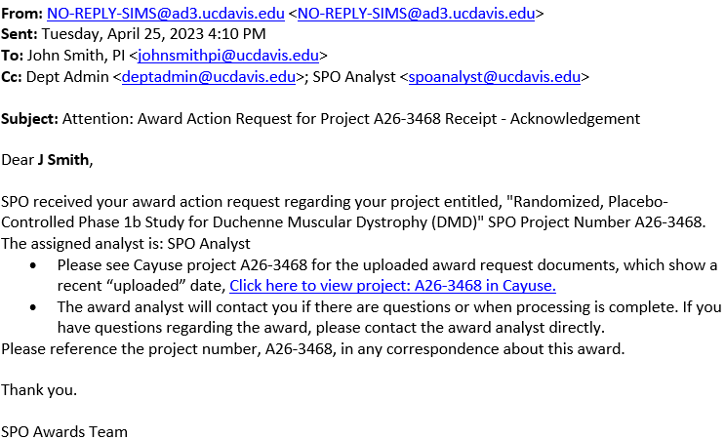
New Prior Approval Request Assignment Email

Slide 7
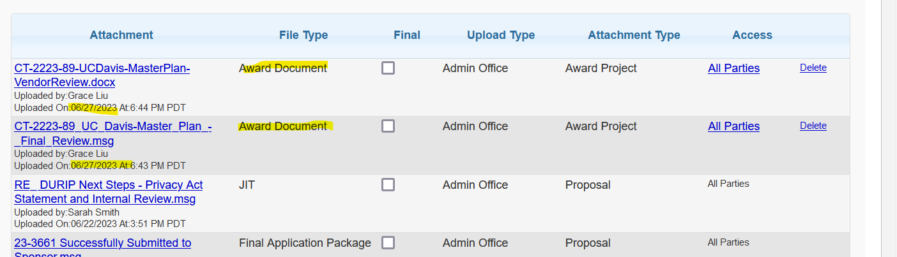
Award information uploaded into Cayuse
At project-level, go to the attachments tab (the paperclip) to see the uploaded award and correspondence

Slide 8
THANK YOU!
Grace Liu
SPO Awards Associate Director

