Slide 1
SPO Awards
February 28, 2024

Slide 2
General Report Reminders
If progress reports or deliverables need an Authorized Organizational Representative (AOR) signature, then you can designate my name (Grace Liu) as the AOR.
and email Grace the report to sign, or designate Grace as the AOR in the electronic system
If AOR does not need to sign the report, then tell the PI to send the report directly to the sponsor—no need for SPO to review
SPO does *NOT* sign financial reports. CGA signs financial reports

Slide 3
NIH progress reports
NIH Research Performance Progress Report (RPPR)
Instructions at this link: https://grants.nih.gov/grants/rppr/rppr_instruction_guide.pdf
A PI with “Progress Report” authority can submit SNAP* awards, but not non-SNAP awards.
Only AOR’s can submit non-SNAP awards
Choose Grace Liu’s name as the AOR in eRA Commons as the Signing Official (SO)
*Streamlined Noncompeting Award Procedures (SNAP)

Slide 4
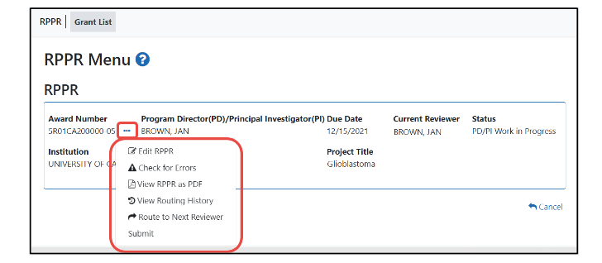
Submitting RPPR
Click on the three-dot ellipsis menu and select “Submit” or “Route to Next Reviewer”
*If the PI cannot submit directly to the NIH, then the “Submit” button will not be enabled.
*The PI must click “Route to Next Reviewer” before SO can submit RPPR. SO cannot submit
when the RPPR is in “PD/PI Work in Progress

