Slide 1
Kate Marusina, Director, Clinical Trials Office
Jackie Dalke, Clinical Research Finance Manager

Slide 2
We are Experts in Clinical Research Implementation
The Clinical Trials Office assists investigators and staff in the conduct of clinical research by providing managed navigation through the clinical research implementation steps at UC Davis.
By working with the CTO you gain expediency and efficiency in achieving your research goal.
CTO website: https://health.ucdavis.edu/ctsc/area/clinical-trials/

Slide 3
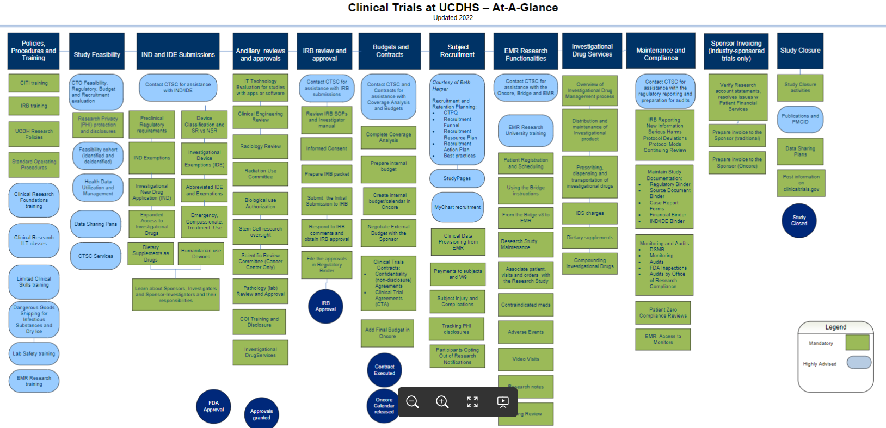
What do we offer?
Our team of
highly trained clinical research coordinators,
regulatory analysts,
participant recruitment specialists,
EMR experts
budget specialists
is available to assist investigators in all phases of a clinical research protocol.
When you contact the Clinical Trials Office for services, the Navigation Project Manager will review your project needs, discuss specifics and create a project plan that may involve experts from many areas of knowledge.

Slide 4
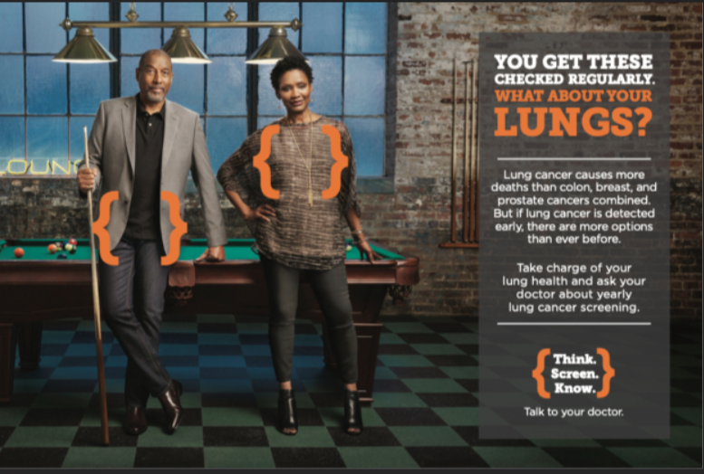
Participant Recruitment (no charge)
Recruitment plans
De-identified cohorts via SlicerDicer technology
Identified cohorts from the Data Provisioning team
Socialize your study using StudyPages platform
Communicate with participants via email, text, or Voice-over-IP
Invite patients to participate via MyChart messaging
Create alerts in EMR for potential study participants
Apply here: https://app.smartsheet.com/b/form/8ac9201a242d464ea4b9a0039fa7ab24
“This team is valuable and incredibly relevant to our researchers. Having the tool along with the support team is critical. We have many tools without the support team or training on the tool- and they are often underutilized.”
Note: public social media campaigns will incur costs (from FB, TV, other media)

Slide 5
Clinical Research Coordinators
“Jimmy proved to be an invaluable addition to the recruitment team, and we could not have done it all without him. We were very impressed with his unwavering dedication to our team and the mission”
Hourly Clinical Research Coordinator ($54/hr) or Regulatory Analyst support ($62/hr)
Hourly support provided to both industry and investigator-initiated studies
We no longer provide start-up support for industry studies
New emphasis: support investigator initiated studies
Opportunity to receive discounted services for projects led by K scholars, early-stage investigators (ESI), and NIH grantees (with emphasis on ESI). Apply here: https://app.smartsheet.com/b/form/bcec86f0d43a4657afa5ce20f78feb81
Lindsay did an exceptional job …She is one of the best coordinators that I have seen and she is able to handle conflict very well. I was impressed that she was able to do this all on a busy Saturday.

Slide 6
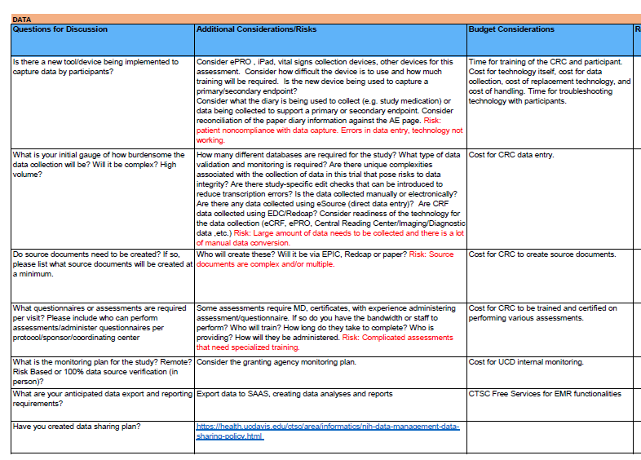
Grant Budgets (for grants with clinical research studies)
Clinical research studies sometimes are difficult to budget
Many items may contribute to budget: coordinator and PI time, procedures, flow-through costs, ancillary services (i.e Pathology, CCRC, Radiology etc)
The CTO Developed a tool that helps to tease out the costs (Unified Feasibility Template)
We help investigators to analyze their protocol and identify relevant budget items
Convert into grant-specific budget template
Apply here: https://app.smartsheet.com/b/form/72a99a17998d4a79925ecd8a991e2c05

Slide 7

Education for Principal Investigators
New! Clinical Research Implementation Course for PIs
Teaches nuts and bolts of clinical research – how to implement a clinical research protocols at UC Davis in a compliant and expeditious manner
~100 hrs of study over 10 weeks
Meeting with 12 experts to discuss their own study idea
First cohort has successfully completed!
Next offering: January 2024
Apply here: https://health.ucdavis.edu/ctsc/area/clinical-trials/investigator-clinical-research-implementation-course

Slide 8
Questions?
Contact:
Kate Marusina, Ph.D., MBA
Director
Clinical Trials Office
kmarusina@ucdavis.edu

