Slide 1
Effort Report Certification 2021-22
Presented by Contracts and Grants Accounting
Amy Bernauer

Slide 2
ERS Certification 2021-22
Calendar & Preparatory Tasks
Communication
No system upgrades this year – review of new features from last year
Help with ERS questions

Slide 3
ERS Calendar
Certification cycle starts in November
Our target start date of November 15 will be delayed due to the ledger close date.
The website calendar has been updated for 2021-22, but once finalized we will send an e-mail to coordinators.
Certification deadline per policy is January 28th (120 days after the end of the period, Sept 30)

Slide 4
ERS Preparatory Tasks
Review training resources on the ERS website and in the UC Learning Center
Permissions
Get permissions requests in early for new staff or changes in responsibilities (submit form)
Update/inactivate permissions for staff who are no longer with your unit (e-mail is OK)
Consider who needs to certify for PIs who have retired or otherwise left the university and submit certification permissions requests

Slide 5
ERS Preparatory Tasks
Report Lists
RECOMMENDED: Coordinators subscribe to PI “My Certifications” and “My Projects” lists (Manage Searches page). These lists appear exactly as they do for your PIs.
Create custom saved searches for your department/unit. If built correctly, these searches will mirror the weekly ERS status reports.
Make appointments to meet with PIs to review their reports and answer their questions or help them to certify. If your PI is leaving the country or will be unavailable at or near the deadline, plan to meet with them before they go.

Slide 6
ERS Communication
We’ll be sending an e-mail to coordinators several days before reports are released so you can begin review.
When reports are released, we’ll send an e-mail to coordinators and PIs.
We will send weekly status reports to coordinators

Slide 7
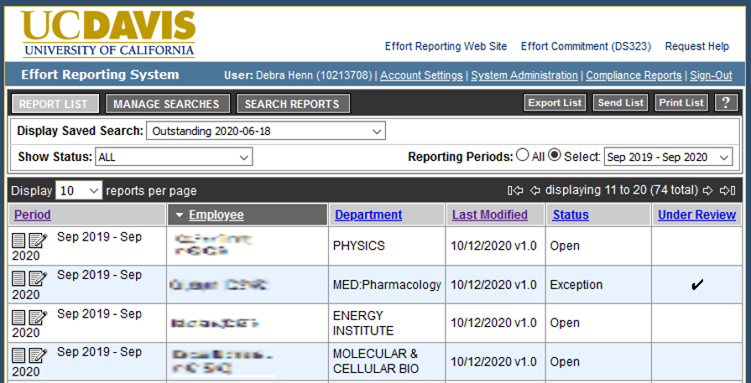
Feature: Under Preliminary Review

Slide 8
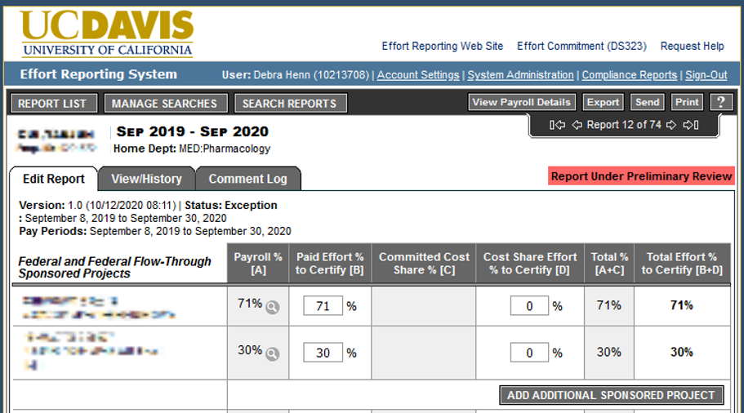
Feature: Under Preliminary Review

Slide 9
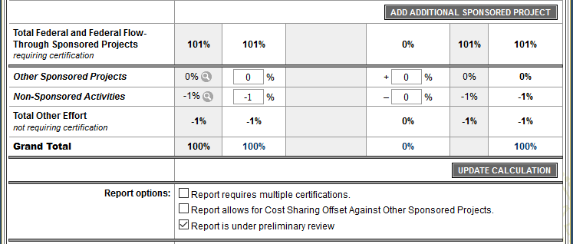
Preliminary Review flag/Comments
Anyone with Coordinator permissions who can open a report can set the flag, no Save required. Coordinators can now also enter comments on the Comments tab.

Slide 10
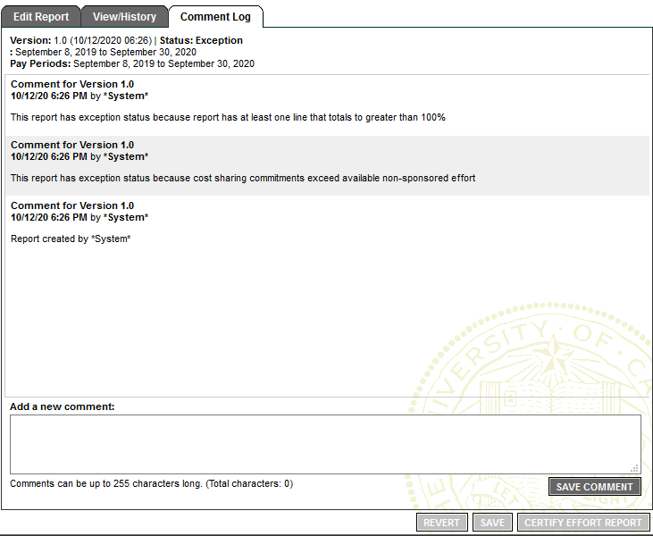
Preliminary Review flag/Comments
Coordinators can also enter comments on the Comments tab to explain why the report is not ready for certification.
Be aware:
Comments are visible to auditors.

Slide 11
How to use Preliminary Review feature
CGA will flag reports that have known, unresolved UCPath issues and will leave an explanation in the Comment Log
ERS Coordinators can flag or un-flag any reports that they question, or the PI questions (such as “needs payroll corrections”) and may enter comments
PIs can flag a report if they think there’s a payroll problem

Slide 12
ERS Help Resources
Jeanene Hayes, Compliance Analyst
New e-mail address: CGA-compliance@ucdavis.edu
ServiceNow ticketing allows us to better track problems, records history of current issue to allow other team members to assist during high volume or coverage for out-of-office.
Help request form on ERS website: https://financeandbusiness.ucdavis.edu/systems/effort-reporting/help-form

Slide 13
Questions?

