Slide 1
SPO Awards
March 27, 2024

Slide 2
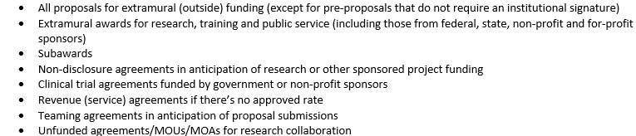
Agreements for SPO Awards
http://research.ucdavis.edu/contact-us/sponsored-programs/

Slide 3
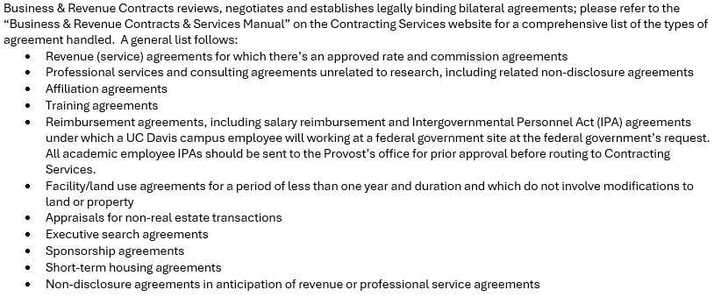
Agreements for Contracting Services
Business & Revenue Contracts
Purchasing
https://supplychain.ucdavis.edu/procure-contract

Slide 4
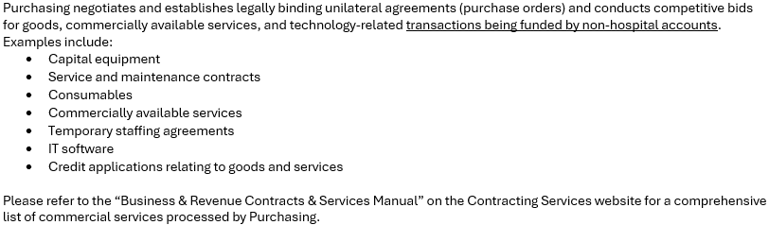
Agreements for Contracting Services

