Slide 1
NEW IRR PROCESS
Contracts and Grants Accounting
July 17, 2023

Slide 2
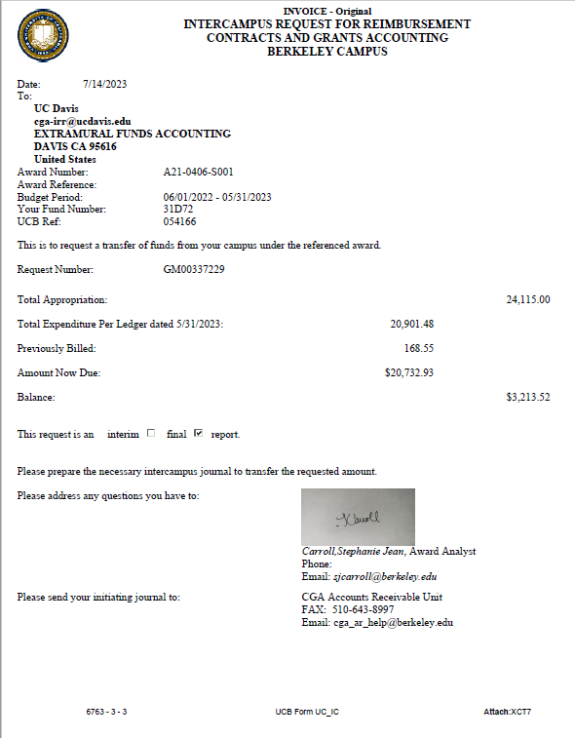
Intercampus Reimbursement Request (IRR)
The IRR is the “invoice” one campus sends another to be reimbursed for expenses on a Multi-Campus Agreement (MCA)
Multi-Campus Agreement is the written agreement between campuses to transfer part of a sponsored project’s funding to another campus.
Finance

Slide 3
IRR – OLD ACCOUNTING PROCESS
MCA – From UCD to Sister Campus
IRR: Sister campus “bills” UCD or UCANR for expense reimbursement
INITIAL BUDGET -- $ PLANNED TO GO TO OTHER CAMPUS(ES) BUDGETED INTO SBMC IN DEPT EXPENSE ACCT
WHEN UCD PAYS OTHER CAMPUS, WE MOVE BUDGET FROM SBMC IN DEPT EXPENSE ACCT TO THE UNEXPENDED BALANCE ACCOUNT
FINANCIAL ENTRY WHICH ACTUALLY PAYS OTHER CAMPUS RECORED IN UNEXPENDED BALANCE
TO UNDERSTAND STATUS OF IRR PAYMENTS YOU MUST LOOK AT BOTH THE EXPENSE AND UB ACCOUNTS – THIS CAN BE CONFUSING
Finance

Slide 4
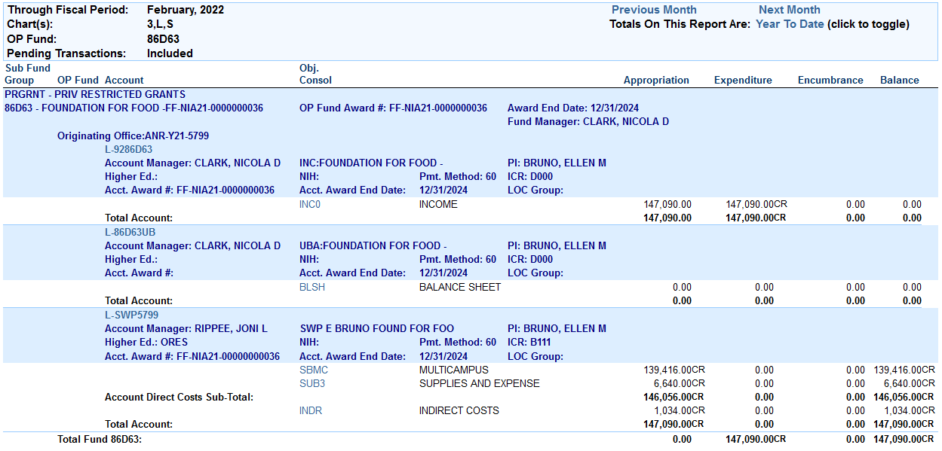
MCA FROM UCANR TO UCB -- LEDGER EXAMPLE
Finance

Slide 5
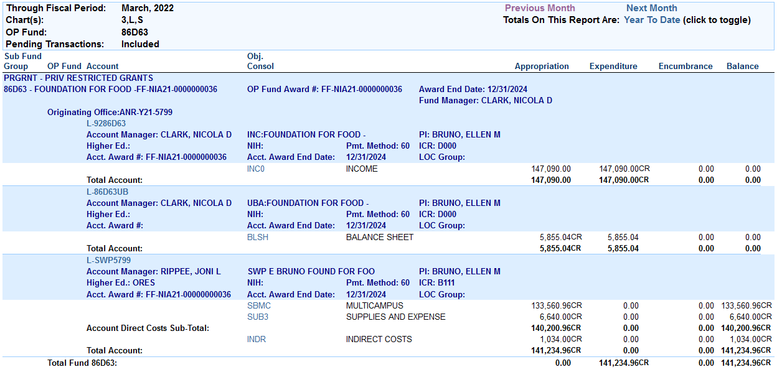
MCA FROM UCANR TO UCB -- LEDGER EXAMPLE
Is this confusing?
Yes!
But wait, there’s good news….
Finance

Slide 6
IRR – NEW ACCOUNTING PROCESS
Implementation of new Common Chart of Accounts required by UCOP starting July 2023 now allows for accounting entries that will result in more transparency on ledgers
Finance

Slide 7
IRR – NEW ACCOUNTING PROCESS
FIS DS-55
This is from the test system….just pretend there’s money in the Appropriation column
Finance

Slide 8
IRR – NEW ACCOUNTING PROCESS
FIS DS-2
Finance

Slide 9
IRR – NEW ACCOUNTING PROCESS
FIS DS-19 (DRILL FROM DS-2)
Finance

Slide 10
IRR – NEW ACCOUNTING PROCESS
UCB PAYS UCD – RECORD INCOME IN INCOME ACCOUNT (92XXXXX)
Finance

Slide 11
Questions?
Finance

