Slide 1
UB Account
A casualty of the new chart of accounts
March 2023

Slide 2
Basic Information
UB Account
In the new chart of accounts, the UB account will be converted to several natural account
Subaward from Sister Campuses
From the perspective of UCD, this is income, the entry will post to the GL
UCD will continue to process IRR’s for reimbursement of expenses
Subaward to Sister Campuses
From the perspective of UCD, this is an expense
Sister Campuses will submit IRR’s for reimbursement of their expenses
Subawards to other campuses will post as a subaward expense to the PPM Project

Slide 3
Natural Accounts
Payment of IRR by sister campus
Payment of IRR to sister campus
Natural Account | Description
724010 | Subcontract Revenue Awarded from UCB
724020 | Subcontract Revenue Awarded from UCSF
724030 | Subcontract Revenue Awarded from UCD
724040 | Subcontract Revenue Awarded from UCLA
724050 | Subcontract Revenue Awarded from UCR
724060 | Subcontract Revenue Awarded from UCSD
724070 | Subcontract Revenue Awarded from UCSC
724080 | Subcontract Revenue Awarded from UCSB
724090 | Subcontract Revenue Awarded from UCI
724100 | Subcontract Revenue Awarded from UCM
724110 | Subcontract Revenue Awarded from UCOP
724120 | Subcontract Revenue Awarded from ANR
Natural Account | Description
725010 | Intercampus Recharges Expense UCB
725020 | Intercampus Recharges Expense UCSF
725030 | Intercampus Recharges Expense UCD
725040 | Intercampus Recharges Expense UCLA
725050 | Intercampus Recharges Expense UCR
725060 | Intercampus Recharges Expense UCSD
725070 | Intercampus Recharges Expense UCSC
725080 | Intercampus Recharges Expense UCSB
725090 | Intercampus Recharges Expense UCI
725100 | Intercampus Recharges Expense UCM
725110 | Intercampus Recharges Expense UCOP
725120 | Intercampus Recharges Expense ANR

Slide 4
PPM – Subaward to Sister Campuses
Budget Category
06 – UC Multi-Campus Participation
Budget can be appropriated to this category
The expenses will post to this category.
This category will also appear in the invoices if there are expenditures.

Slide 5
PPM – Subaward to Sister Campuses
A Requisition will be set up by CGA for each subaward to a sister campus.
The requisition will become a P/O, once the requisition is approved by the Project Manager.
System will generate the commitment associated to the PO
When an IRR is received from a sister campus, it will be processed against the P/O.

Slide 6
PPM – Subaward to Sister Campuses
The IRR and its attachments will route to the Project Manager and PI for approval.
The amount in commitments will be adjusted to reflect the amount that posted to expenditures.
When the work is completed and a final invoice is processed, the P/O can be closed.

Slide 7
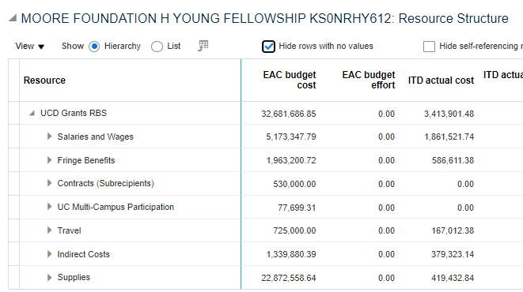
PPM – Subaward to Sister Campuses

Slide 8
Natural Accounts
Other recharges credit of sister campus
Other recharges expense from sister campus
Natural Account | Description
785010 | Intercampus Recharges Credit UCB
785020 | Intercampus Recharges Credit UCSF
785030 | Intercampus Recharges Credit UCD
785040 | Intercampus Recharges Credit UCLA
785050 | Intercampus Recharges Credit UCR
785060 | Intercampus Recharges Credit UCSD
785070 | Intercampus Recharges Credit UCSC
785080 | Intercampus Recharges Credit UCSB
785090 | Intercampus Recharges Credit UCI
785100 | Intercampus Recharges Credit UCM
785110 | Intercampus Recharges Credit UCOP
785120 | Intercampus Recharges Credit ANR
Natural Account | Description
780010 | Intercampus Recharges Expense UCB
780020 | Intercampus Recharges Expense UCSF
780030 | Intercampus Recharges Expense UCD
780040 | Intercampus Recharges Expense UCLA
780050 | Intercampus Recharges Expense UCR
780060 | Intercampus Recharges Expense UCSD
780070 | Intercampus Recharges Expense UCSC
780080 | Intercampus Recharges Expense UCSB
780090 | Intercampus Recharges Expense UCI
780100 | Intercampus Recharges Expense UCM
780110 | Intercampus Recharges Expense UCOP
780120 | Intercampus Recharges Expense ANR

