Slide 1


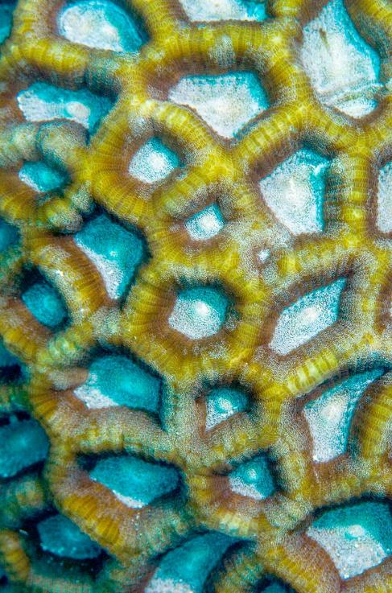

Research administration Forum Proposals & Subawards
August 2023

Slide 2


Recruitment update
Proposals: 1 RA2 Vacancy
Status: Reference checks
Subawards: 1 RA3 Vacancy
Status: Tentative start date of 9/1/23

Slide 3

NIH Data management & sharing (DMS) costs

Slide 4
Update: budgeting for dms costs
Effective for applications submitted for due dates on or after October 5, 2023, NIH will no longer require the use of the single DMS cost line item.
DMS costs must be requested in the appropriate cost category (e.g., personnel, equipment, etc.).
NIH will require applicants to specify estimated DMS cost details within the “Budget Justification” (R&R Budget Form) or “Additional Narrative Justification” (Modular Budget Form), pursuant to the instructions.
Updates to the NIH How to Apply – Application Guide will be published prior to the October 5, 2023, effective date.
Source: NOT-OD-23-161: NIH Application Instruction Updates Data Management and Sharing (DMS) Costs

Slide 5
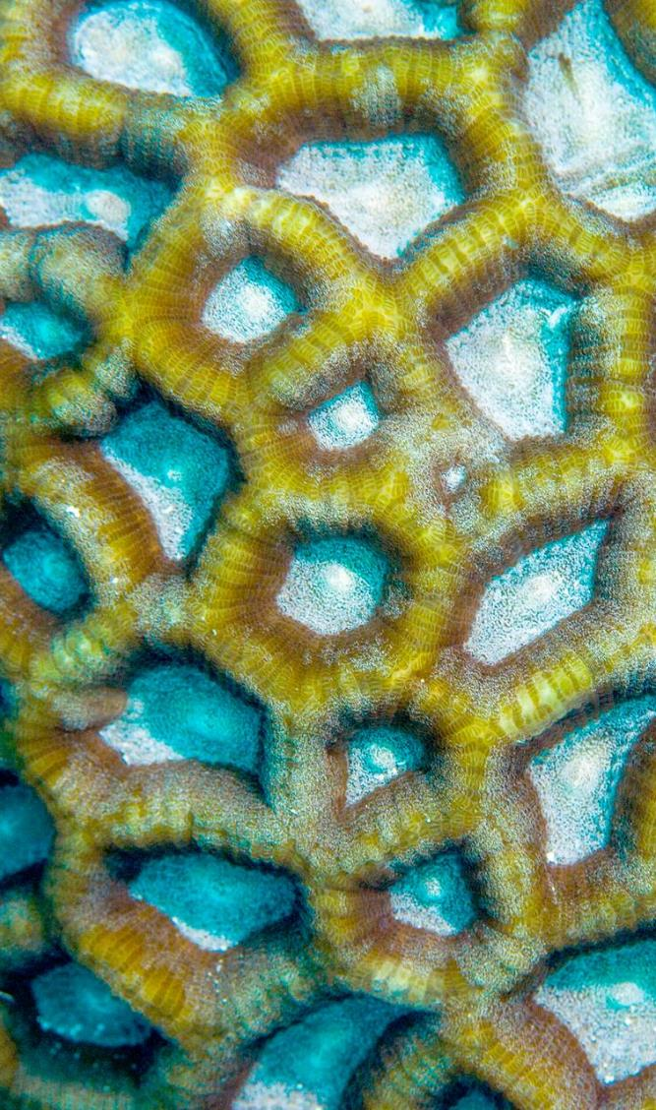

Questions?

Slide 6

THANK YOU

