Slide 1

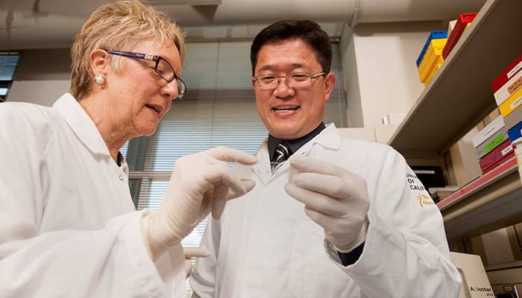
Research Ethics and Compliance OFFICE HOT TOPICS
ALAISHA m.Hellman, Director
July 26,2023

Slide 2

Research Administration Forum
Research Ethics and Compliance Office Hot Topics
WELCOME TO ORA / RAS: DISCOVER YOUR PATH
StrengthsFinder
RCR Updates
  NSF Changes
  Updated Certificate Program
Summer Travel Compliance tips
DoD Policy on Countering Unwanted Foreign Influence in Fundamental Research

Slide 3
RCR Updates
INSERT DATE

Slide 4
Responsible Conduct of Research Updates
WELCOME TO ORA / RAS: DISCOVER YOUR PATH
StrengthsFinder
NSF Changes
  Who is required?
  What is newly required?
Updated Certificate Program
  Changes to address the concerns
  Updated live Zoom series topics

Slide 5
Responsible Conduct of Research Updates
WELCOME TO ORA / RAS: DISCOVER YOUR PATH
StrengthsFinder
NSF expanded who is required to take the RCR Training
  NSF has expanded who is required to take the RCR training. It will soon be required for Principal Investigators and for senior personnel (i.e., faculty and other academic appointees), as well as postdoctoral scholars and students, who are supported on new NSF grant proposals submitted on or after July 31, 2023.

Slide 6
Responsible Conduct of Research Updates
WELCOME TO ORA / RAS: DISCOVER YOUR PATH
StrengthsFinder
NSF RCR new requirements:
  New requirements specify that training is required on the topics of mentor training and mentorship; research security threats awareness training; and federal export control, disclosure, and reporting requirements.

Slide 7
Responsible Conduct of Research Updates
WELCOME TO ORA / RAS: DISCOVER YOUR PATH
StrengthsFinder
RECO updated RCR Program Updates
  CITI training includes topics of mentor training and mentorship; research security threats awareness training; and federal export control, disclosure, and reporting requirements.

Slide 8
Responsible Conduct of Research Updates
WELCOME TO ORA / RAS: DISCOVER YOUR PATH
StrengthsFinder
RECO updated RCR Program Updates
  New updated live Zoom series to include new topics.

Slide 9
Responsible Conduct of Research Updates
WELCOME TO ORA / RAS: DISCOVER YOUR PATH
StrengthsFinder
RCR questions
  Please contact the RCR Coordinator Elizabeth Chase at ORRCI@ad3.ucdavis.edu

Slide 10
Summer Research Travel Tips
INSERT DATE

Slide 11
Summer Research Travel Tips
WELCOME TO ORA / RAS: DISCOVER YOUR PATH
StrengthsFinder
As summer approaches, when important international travel, research, and collaborations take place, the Research Ethics and Compliance Office (RECO), which serves as the UC Davis export control office, would like you to keep in mind that when faculty and staff travel abroad, everything they take is an export.

Slide 12
Summer Research Travel Tips
WELCOME TO ORA / RAS: DISCOVER YOUR PATH
StrengthsFinder
What should you think about when engaging internationally and how can RECO help? The government has regulations around who, what, where, and why.

Slide 13
Summer Research Travel Tips
WELCOME TO ORA / RAS: DISCOVER YOUR PATH
StrengthsFinder
The “who” can be individuals in or from a sanctioned or embargoed country or an individual or entity on one of the sanctioned lists. RECO can check those lists for you.

Slide 14
Summer Research Travel Tips
WELCOME TO ORA / RAS: DISCOVER YOUR PATH
StrengthsFinder
The “what” is the export of specific items, software, or technology. This can be the transporting of specialized equipment, substances, materials, toxins, and/or biologics, unpublished or proprietary information or data. RECO can help you determine the export classification of an item.

Slide 15
Summer Research Travel Tips
WELCOME TO ORA / RAS: DISCOVER YOUR PATH
StrengthsFinder
The “where” are countries facing embargoes and sanctions. There are specific economic and trade sanctions administered against Iran, Cuba, Russia, Belarus, Syria, Venezuela, and North Korea. If you plan to travel, research, attend a conference, or participate in other engagements in an embargoed and sanctioned country, RECO will help you navigate the regulations and requirements.

Slide 16
Summer Research Travel Tips
WELCOME TO ORA / RAS: DISCOVER YOUR PATH
StrengthsFinder
The “why” is due to concerns around national security, foreign policy, and trade protection. A license may be required depending on the destination, individual receiving/using, or application/function. Please contact RECO as soon as possible for assistance in determining if you will need an export license which can take several months.

Slide 17
Summer Research Travel Tips
WELCOME TO ORA / RAS: DISCOVER YOUR PATH
StrengthsFinder
What else should I know?
In some cases, the export of encryption software requires a license. Bringing your laptop with encryption software to certain countries or using USD’s VPN software, DUO, in certain countries without proper authorization could violate U.S. export law or the import regulations of the country to which you are traveling. There are several countries that restrict the import, export, or use of encrypted devices and software.
Please check with the US Department of State before traveling internationally to ensure that you have the most up-to-date information or contact the RECO office for assistance.

Slide 18
Export Control Questions
WELCOME TO ORA / RAS: DISCOVER YOUR PATH
StrengthsFinder
Questions?
Email or_export@ou.ad3.ucdavis.edu

Slide 19
DoD Policy on Countering Unwanted Foreign Influence in Fundamental Research
INSERT DATE

Slide 20
DoD Countering Foreign Influence
WELCOME TO ORA / RAS: DISCOVER YOUR PATH
StrengthsFinder
Due to concerns of foreign government influence, beginning August 9, 2024, the DoD is prohibited from providing funding or awarding individuals who are participating in a malign foreign government-sponsored talent recruitment program or who fail to have a policy addressing such programs.

Slide 21
DoD Countering Foreign Influence
WELCOME TO ORA / RAS: DISCOVER YOUR PATH
StrengthsFinder
Why?
Ensure security of research
Ensure full disclosure by covered individuals
Clear messaging on acceptable behavior

Slide 22
DoD Countering Foreign Influence
WELCOME TO ORA / RAS: DISCOVER YOUR PATH
StrengthsFinder
New strategies to mitigate risk:
Risk Awareness Training
Increased Reporting
Review and Clarify Relationships
Require to resign

Slide 23
DoD Countering Foreign Influence
WELCOME TO ORA / RAS: DISCOVER YOUR PATH
StrengthsFinder
Risk Matrix showing risk factors and mitigation measures
Factors:
Talent Program
Funding Sources
Patents
Entity List

Slide 24
DoD Countering Foreign Influence
WELCOME TO ORA / RAS: DISCOVER YOUR PATH
StrengthsFinder
Questions?
Email or_export@ou.ad3.ucdavis.edu

