Slide 1
Cutover to Aggie Enterprise
Items of interest
August 2023

Slide 2
Presentation Objective
Communicate to the Research Administration Forum attendees items of interest to facilitate the cutover and going live process.

Slide 3
Cutoff Dates - Kuali
Activity | Date
Last day for UCD Office of Research and ANR Contract & Grants to send CGA awards and amendments | Nov. 17, 2023
Last day for CGA to create new sponsored awards or process new amendments | Nov. 20, 2023
Last day to create new expense account for sponsored awards | Nov. 21, 2023
Last day for departments to process subaward invoices in Kuali (fully approved including CGA’s approval, if necessary by 12/11/23) | Dec. 11, 2023
Last day for UCD Office of Research and ANR Contract & Grants to send CGA subaward contract to process in Kuali | Dec. 13, 2023
Last day for departments to process payment requests in Kuali (fully approved including CGA’s approval, if necessary by 12/22/23) | Dec. 18, 2023
Last day for departments to process cost transfers using GEC (fully approved including CGA’s approval, if necessary) | Jan. 04, 2024

Slide 4
Information
Each Kuali award (fund) that has not been closed (i.e. close code FGDHHS) and/or have a balance will be migrated to Aggie Enterprise as an award and all the expense accounts, including expired ones, as projects.
Each Kuali award (fund) will be converted as a PPM award.
Each expense account associated with a converted Kuali award (fund) will become an Oracle project.
Each Oracle sponsored project will be assigned a task (TASK01). This restriction will be reevaluated once the system has gone live and stabilized.

Slide 5
Information
Expense Account with no appropriations (budget) will be converted to PPM appropriating $1.00 in the category 3- Supplies / Services and Other Expenses.
Expenses will be converted to Oracle as balances per natural accounts (a natural account might be associated with one or multiple Kuali object codes)
This conversion will be done in three parts:
Balances as of Fiscal Year 2023
Expenditures total for the period July to November 2023
Expenditures for the month of December 2023.

Slide 6
Information
Once the conversion is completed and the reconciliation done, CGA/PPM Team will create the cost share project manually in Oracle.
No expenditures will be migrated to the cost share projects.
It will be necessary to create a task for each fund source that will fund the cost share expenses.
Once the conversion is completed and the reconciliation done, CGA/PPM Team will associate the sponsored capital and fabrication projects to the award manually in Oracle.

Slide 7
Action Items
Action | Deadline
Clear all your overdrafts, unless additional funds are expected. | 12/01/2023
Clear all your encumbrances associated with PO that are no longer required. | 12/01/2023
Clear encumbrances of subawards that have ended and have been completely invoiced. | 12/01/2023
Expire all Contracts and Grants expense accounts that are no longer needed. | 12/06/2023
Clear all negative budgets, with the exception of LEAVE ASSESSMENT & USAGE. | 11/21/2023

Slide 8
Action Items
Departments might want to notify subawardees of impending UCD migration to Aggie Enterprise and request that invoices be submitted by Dec. 8, 2023. If not the invoices will be paid in January
Departments should determine if advances to subawardees will need to be processed during the cutover period and process them at the beginning of December 2023.
Process all cost transfers as soon as possible, after these are identified and approved by the PI.
If an award has a final invoice or financial report due in December 2023 or January 2024 try to request an extension for the submission of these documents. If approved by the sponsor, should copy Office of Research and CGA.

Slide 9
Questions
If you have additional questions or commentaries, you can send an email to:
- Francisco Andrade fcoandrade@ucdavis.edu
- Valerie Cruz vjcruz@ucdavis.edu
- Stephanie Mata smmata@ucdavis.edu

Slide 10
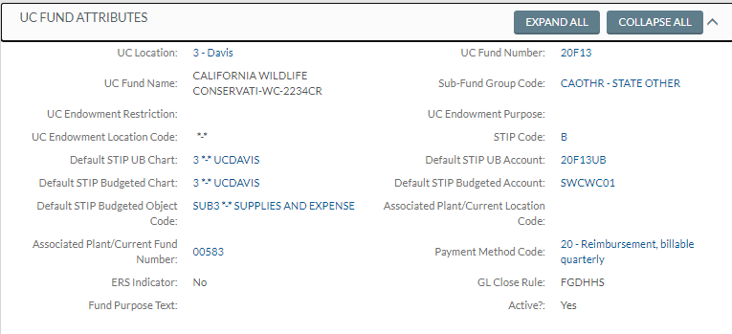
Close Code
When an award is fully closed, CGA changes the GL Close Code in Kuali from FGDHHS to FGDHHC.
Awards with GL Close Code FGDHHS as of Fiscal Close 2023 will be migrated with all the associated expense accounts.

Slide 11
Negative budgets
 |  |  | Appropriation |  | Expenditures |  | Encumbrance | Balance
3-NGBUDGE
Account Manager: DAUGHERTY, LEAH M | RMS Evaluate Mitochondrian behavior in Parkinson |  | PI: HATHAWAY, NICOLE E
Higher Ed.: Emily Dickinson | Pmt. Method: 10 |  | ICR: J260
Acct. Award #: A22-9999 | Acct. Award End Date: | 2/1/2024
 | SUBG | GENERAL ASSISTANCE | 8,995.02 | CR | 7,995.02 |  | - | 1,000.00
 | SB28 | LEAVE ASSESSMENT & USAGE | 352.37 |  | 352.37 | CR | - | -
 | SUB3 | SUPPLIES AND EXPENSE | 2,352.26 |  | 2,352.26 | CR | - | -
 | SUB6 | EMPLOYEE BENEFITS | 3,595.01 | CR | 3,095.01 |  | - | 500.00
Account Direct Costs Sub-Total: |  |  | 9,885.40 | CR | 8,385.40 |  | - | 1,500.00
 | INDR | INDIRECT COSTS | 2,570.20 | CR | 1,660.60 |  | - | 909.60
Total Account: |  |  | 12,455.60 | CR | 10,046.00 |  | - | 2,409.60

