Slide 1
Cutover to Aggie Enterprise
Contracts and Grants – Critical Dates
May 2023

Slide 2
Presentation Objective
Communicate to the Research Administration Forum attendees the cutover calendar dates that will affect activities associated with post-award administration of contracts and grants.

Slide 3
Proposals
Proposals
Proposals are not affected by the migration to Aggie Enterprise

Slide 4
New Awards and Projects
The last day for UCD Office of Research and ANR Contract & Grants to send CGA documents is Nov. 17, 2023
New Awards
Documents will be sent to CGA to be processed by Nov. 20, 2023.*
CGA will not have access to the screens needed to setup or modify awards as of 11/20/23 at 8:30 p.m.
Department will be notified to create expense accounts. This should be completed including the approval by 11/21/23 at 8:30 p.m.
Notes:
CGA will do its best effort to set up the awards processed by UCD Office of Research and ANR Contracts & Grants but there might be issues that will impede the completion of the process (such as missing information, amount discrepancies)

Slide 5
New Awards and Projects
The last day for UCD Office of Research and ANR Contract & Grants to send CGA documents is Nov. 17, 2023
New Awards
Action Steps
If award cannot be sent to CGA on or prior to Nov. 17, 2023 and project activities start before Jan. 03, 2024:
Process a request to set up an advance account on or before Nov. 17, 2023
If not able to process an advance account, expenses should be charged to a department account. When Aggie Enterprise goes live then department will transfer the expenses to the new award.
Notes:
*Advance Account requests require written commitment of award (See 'firm commitment' definition in https://www.ucop.edu/research-policy-analysis-coordination/resources-tools/contract-and-grant-manual/chapter6/chapter-6-300.html. The request for an advance account will have to be compliant with UC policy.

Slide 6
New Awards and Projects
The last day for UCD Office of Research and ANR Contract & Grants to send CGA documents is Nov. 17, 2023
New Awards
Action Steps
If project start on or after Jan. 03, 2024, then it might not be necessary to set up an advance account. Department should request CGA to give priority to the award setup.
Notes:
*Advance Account requests require written commitment of award (See 'firm commitment' definition in https://www.ucop.edu/research-policy-analysis-coordination/resources-tools/contract-and-grant-manual/chapter6/chapter-6-300.html. The request for an advance account will have to be compliant with UC policy.

Slide 7
Amendments
The last day for UCD Office of Research and ANR to send CGA Contracts & Grants is Nov. 17, 2023
Amendments
CGA will not be able to process any amendment after November 20, 2023.
If an amendment in Kuali requires to set up a new account, the department should set it up and approve it by Nov. 17, 2023. If possible the account manager should send a note to CGA informing that an expense account has been created and needs to be approve by Nov. 20, 2023.

Slide 8
Amendments
The last day for UCD Office of Research and ANR to send CGA Contracts & Grants is Nov. 17, 2023
Amendments
If an amendment processed after Nov. 17, 2023 requires a new account, the department should use the existing account to post expenditures. After the new project is setup then the department can transfer the expenses.

Slide 9
Subawards to Other Institutions
The last day for UCD Office of Research and ANR Contract & Grants to send CGA documents is Dec. 12, 2023
Subawards to Other Institutions
Documents will be sent to CGA to be processed by Dec. 12, 2023.
CGA will not have access to the screens needed to setup or modify subawards (NPA’s) as of 12/13/23 at 8:30 p.m.
Documents received in CGA after that date will be processed in Aggies Enterprise once it goes live.

Slide 10
Subawards to Other Institutions
The last day for UCD Office of Research and ANR Contract & Grants to send CGA documents is Dec. 12, 2023
Subawards to other institutions
Action Steps
If a subawardee submits an invoices during the period Dec. 13, 2023 and Jan. 3, 2024, it will have to be processed in Aggie Enterprise after it goes live.
If a subawardee submits an invoices during the period Dec. 13, 2023 and Jan. 3, 2024, that has not been set up; the department should send an email to CGA in order for the subaward to be given priority in setting it up.

Slide 11
Expense Transfers
Contracts & Grants Expense Transfer
Departments and CGA will be allowed to process expense transfer till Jan. 4, 2024.
GEC and JV have to be fully approved by 6:00 p.m.

Slide 12
Payment Request
Payment Requests
Departments and CGA will be allowed to process payment requests till Dec. 13, 2023 at 6:00 p.m.
Payment Requests have to be fully approved by Dec. 13, 2023 at 6:00 p.m.
Payment requests after Dec. 13, 2023 will be processed in Aggie Enterprise after it goes live.

Slide 13
Disbursement Vouchers
Disbursement Vouchers
Departments and CGA will be allowed to process disbursement vouchers till Dec. 21, 2023 at 8:30 p.m.
Disbursement Vouchers have to be fully approved by Dec. 22, 2023 by 6:00 p.m.
Disbursement Vouchers after Dec. 21, 2023 will be processed in Aggie Enterprise after it goes live.
An emergency process has been set up in case a payment is required during the Dec. 22, 2023 and AE going live. In this case Department should contract A/P.

Slide 14
Suggestions
Departments might want to notify subawardees of impending UCD migration to Aggie Enterprise and request that invoices be submitted by Dec. 8, 2023. If not the invoices will be paid in January
Departments should determine if advances to subawardees will need to be processed during the cutover period and process them at the beginning of December 2023.
Process all cost transfer as soon as possible, after these are identified and approved.
If an award has a final invoices or financial reports due in December 2023 or January 2024 try to request an extension for the submission of these documents. If approved by the sponsor, should copy Office of Research and CGA.

Slide 15
Suggestions
Clear overdrafts.
Clear encumbrances associated with PO that are no longer required.
Clear encumbrances of subawards that have ended and have been completely invoiced.
Expire all Contracts and Grants expense accounts that are no longer needed.

Slide 16
Information
Each award (fund) that has not been closed (i.e. close code FGDHHS) will be migrated to Aggie Enterprise as an award and all the expense accounts, including expired ones, as projects.
Reimbursement invoices for expenses that posted in Dec. 2023 will be processed in Aggie Enterprise in Jan. 2024.
CGA will set up a cost share project for each award that has committed cost share. After Aggie Enterprise goes live, all cost share expenditures should post to the cost share project. There will not be a migration of the expenditures from the present Cost Share System.

Slide 17
Questions
If you have additional questions or commentaries, you can send an email to:
- Francisco Andrade fcoandrade@ucdavis.edu
- Valerie Cruz vjcruz@ucdavis.edu
- Stephanie Mata smmata@ucdavis.edu

Slide 18
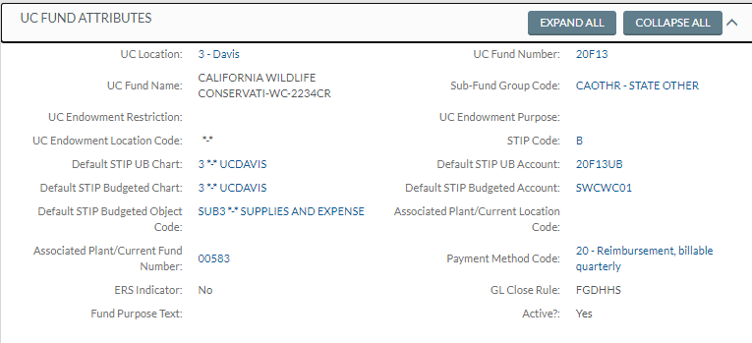
Close Code
When an award is fully closed, CGA changes the GL Close Code in Kuali from FGDHHS to FGDHHC.
Awards with GL Close Code FGDHHS as of Fiscal Close 2023 will be migrated with all the associated expense accounts.

