Slide 1
Contracts & Grants Accounting
Research Administration Forum – February 28, 2024

Slide 2
CGA
Director: James Ringo
Assoc. Director: Mario Reina-Guerra
Full Staff List: https://financeandbusiness.ucdavis.edu/contact/staff-directory/contracts
Award Management
Revenue Management
Award Maintenance (Setup/Amendments/Closeout)
Supervisor: Lenora Bruce
AE “Grant Administrators”
Invoicing and Reporting
Supervisors: Tammy Castelli and Jenny Scales
AE “Contract Administrators”
Instructions to lookup Grant Admin: KB0010188
Instructions to lookup Contract Admin: KB0010263
Compliance/Training
Supervisor: Debra Henn
Cash and Receivables
Supervisor: Stephanie Mata
Finance

Slide 3
AE Updates
Successfully closed January 2024 ledgers – next up February
GSR Fee Remission Rebate
-- process is in final system testing
-- to be deployed before closing Feb
Close dates: 60 days from project end date
Invoicing / cash draws -- underway

Slide 4
Award/Amendment Processing
Finance

Slide 5
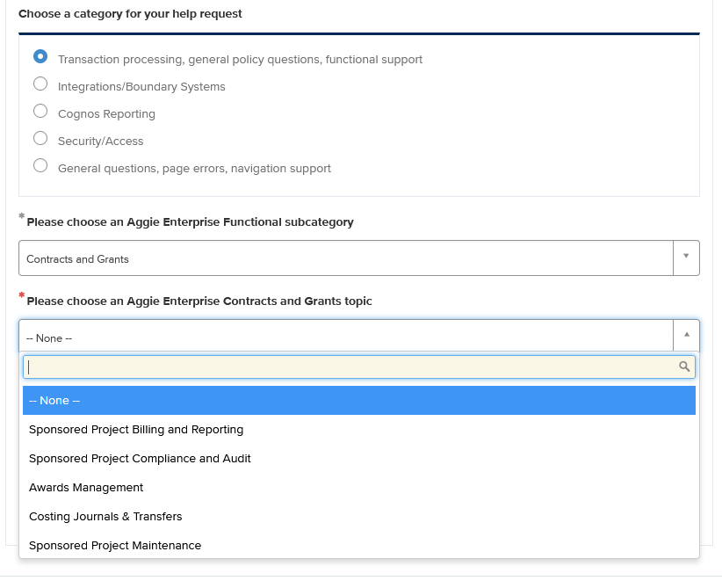
Service Now
Open Tickets with Aggie Enterprise Help form
(https://servicehub.ucdavis.edu/servicehub?id=ucd_cat_item&sys_id=69aaee7a1bf7291094087bff034bcb48)
To get to CGA, select:
1,122 Tickets opened since go-live
60% resolved
Biggest backlog – Cost Transfers
“Strike Team” in place
Finance

Slide 6
Finance AE Office Hours
https://aggieenterprise.ucdavis.edu/office-hours
Aggie Enterprise functional leads host drop-in office hours for users to ask questions and get assistance with Aggie Enterprise processes. Users are encouraged to join via Zoom at any time during the session. These will be true drop-in office hours with no facilitated presentations.
PPM C&G Breakout Room
10-11am Tuesday – Thursday
Finance

Slide 7
Questions
???
Finance

