Slide 1
Contracts & Grants Accounting
Aggie Enterprise Updates for Research Administration Forum
– January 24, 2024

Slide 2
Agenda
CGA Organization
Award Processing
Finance Office Hours
Data Issues
KBAs
Finance AE Office Hours
Finance

Slide 3
CGA
Director: James Ringo
Assoc Director: Mario Reina-Guerra
Full Staff List: https://financeandbusiness.ucdavis.edu/contact/staff-directory/contracts
Award Management
Revenue Management
Award Maintenance
Supervisor: Lenora Bruce
AE “Grants Administrators”
Invoicing and Reporting
Supervisors: Tammy Castelli and Jenny Scales
AE “Contract Administrators”
Compliance/Training
Supervisor: Debra Henn
Cash and Receivables
Supervisor: Stephanie Mata
Finance

Slide 4
AE Award Processing
Transition Hold from mid-November 2023 to January 8, 2024
Started transacting in AE on Jan 8
New Awards 114 processed / 79 to be processed
Starting this week
Amendments 620
Subawards 230
Finance

Slide 5
Top 3 New Ways of Doing Things
Award Setup
When PM receives Budget – This is notification the award is ready to go
Review Budget AND Award/Project Data (KBA coming soon)
Subawards
CGA still sets them up
Send subaward invoices to invoicing@ucdavis.edu
Subaward invoices will automatically route for PI approval (via email). This replaces old process of having PI sign each invoice.
See KB0009733; https://kb.ucdavis.edu/?id=09733
One Task Per Sponsored Project
Implementation designed for one task / project
Request additional Projects as needed for reporting and/or award management requirements
Finance

Slide 6
Data Issues / Cleanup Projects
Award / Project End Dates
Purpose Codes
Financial Organization
Project Manager (used to be “fiscal officer” in KFS)
Principal Investigator
Finance

Slide 7
Knowledge Base Articles
Note: Don’t try to apply KBAs that say “for Non-sponsored Project” to Contract/Grant Awards
Project Portfolio Management
20 Articles Available Now, including:
Look Up the CGA Grants or Contracts Administrator for a PPM Award or Project
Running the PPM Master Data Report
Transferring Costs Between PPM Projects and/or Tasks
Delegating PPM Project Manager Approvals
Additional CGA specific articles coming soon:
Understanding Award/Project dates
New award setup
Award closeouts
And more!!!
Finance

Slide 8
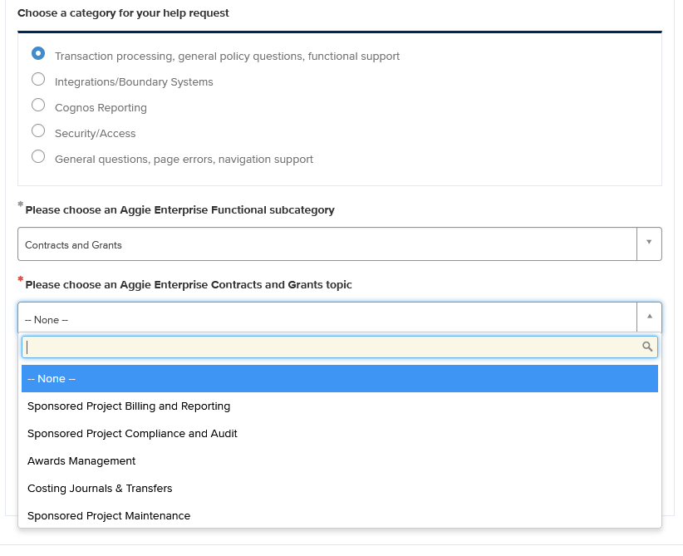
Service Now
Open Tickets with Aggie Enterprise Help form
(https://servicehub.ucdavis.edu/servicehub?id=ucd_cat_item&sys_id=69aaee7a1bf7291094087bff034bcb48)
To get to CGA, select:
Finance

Slide 9
Finance AE Office Hours
https://aggieenterprise.ucdavis.edu/office-hours
Aggie Enterprise functional leads host drop-in office hours for users to ask questions and get assistance with Aggie Enterprise processes. Users are encouraged to join via Zoom at any time during the session. These will be true drop-in office hours with no facilitated presentations.
PPM C&G Breakout Room
10-11am Monday –Friday
Finance

Slide 10
Questions
???
Finance

