Slide 1
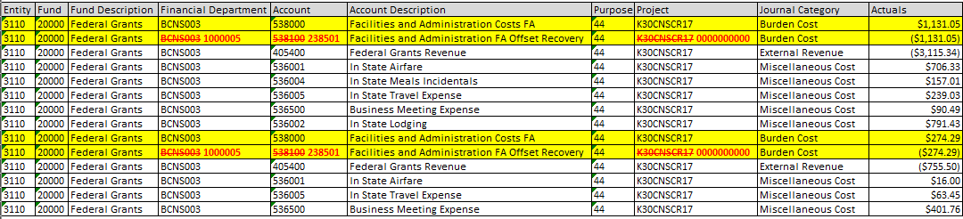
Indirects
Incorrect ledger posting:

Slide 2
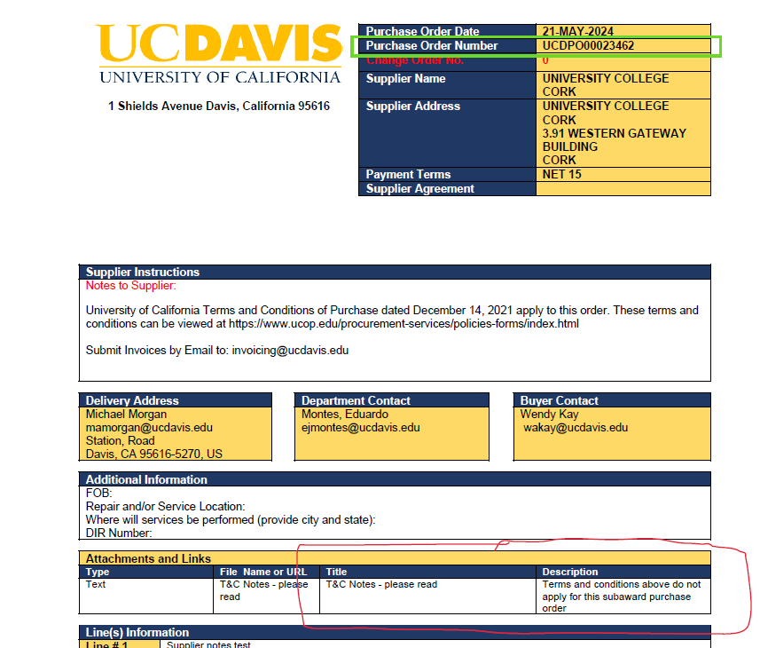
Subaward POs

