Slide 1
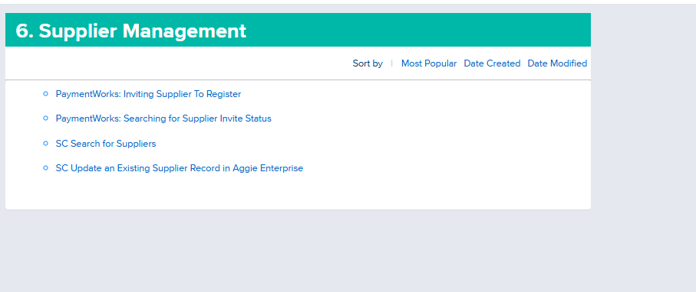
Subawards
Verify Subrecipient/Subawardee is active in Aggie Enterprise
If not active, add them as a supplier via PaymentWorks
Supply Chain KBAs
Finance

