Slide 1
Effort Reporting (ERS) Updates 2023-2024
We will be sending requests for permissions review in October
Effort Reports are scheduled to be released on the normal schedule for 2023-24: November 15 or within a few days of that.
ERS has been upgraded so it works with the new chart strings and will include the entity, dept, project, and award for the FAU in ERS

Slide 2
Sample report showing how the old federal account/fund will be on a separate row from new project/award.
Request Help links to the
ERS | Help Request Form
KFS Account
Pay period Oct-Dec 2023
Cognos – UCP-339 Historical
If you hold your cursor over the federal sponsored project cell it will populate the PI, Grant title, OP Fund and Sponsor Award#
New AE Project Number
Pay period Jan-Sep 2024
Cognos – UCP-339

Slide 3
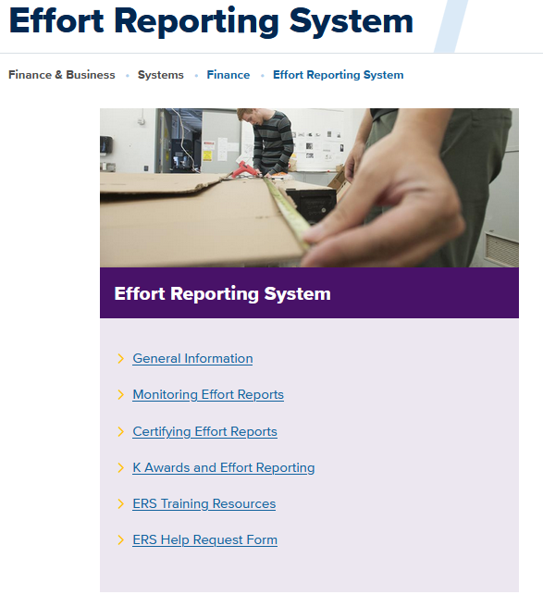
ERS Coordinator Training/Resources
ERS BRIEFING FOR COORDINATORS in the UC Learning Center
Overview of the policies, procedures, responsibilities of the department ERS Coordinator and demonstrations of tools in ERS to help monitor completion.
Effort Reporting System Website
ERS Frequently asked questions (FAQs)

Slide 4
Ways you can request help
Email CGA-compliance@ucdavis.edu
ERS |Help request form on the ERS website
Request help located on the top right of the ERS report

