Slide 1
Research Forum
Sponsored Programs Updates
July 23, 2025

Slide 2
Agenda
Update on Federal Indirect Cost Rate Caps
NIH Foreign Involvement
New OR Budget Template Features
Contacts for Questions

Slide 3
Federal Indirect Cost Rate Caps
Litigation is ongoing related to recent federal indirect costs caps of 15% MTDC.
Use our federally negotiated rates for all federal sponsors that do not have a historical program cap.
Disclaimer language should be added to proposal budget justifications for some agencies:
Agency | Statement Required?
National Institutes of Health (NIH)/DHHS | Not Required at this time
Department of Defense (including CDMRP) | Required (see following slides.)
National Science Foundation | Required (see following slides.)
Dept of Energy (DOE) | Not Required at this time

Slide 4
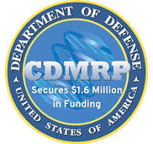
Federal Indirect Cost Rate Caps
Department of Defense, including CDMRP:
Include the following text in the budget justification:
We are submitting this application using the indirect cost rate as stipulated in our federally negotiated rate agreement. We note that as of June 17, 2025, application of the 6/12/25 Department of Defense internal Memorandum “Implementation of a 15% Indirect Cost Cap on Assistance Awards to Institutions of Higher Education” is temporarily enjoined, in connection with the Temporary Restraining Order (TRO) issued in connection with AAU v. DoD (D. Mass., No. 25-cv-11740). We therefore plan to draw down in accordance with the University’s negotiated rate. We reserve the right to challenge attempted retroactive application of the 15% IDC rate cap memo should the TRO be lifted or should there be another court ruling allowing implementation of the rate cap specified in the Memo.

Slide 5

Federal Indirect Cost Rate Caps
National Science Foundation
Include the following text in the budget justification:
We are submitting this application using the indirect cost rate as stipulated in our federally negotiated rate agreement. We note that on June 20, 2025, the U.S. District Court for the District of Massachusetts (in AAU et al. v. NSF et al, No. 1:25-cv-11231-IT) granted Plaintiffs’ summary judgment motion and vacated NSF’s 15% Indirect Cost Rate Policy (NSF 25-034). We therefore plan to draw down in accordance with the University’s negotiated rate. We reserve the right to challenge attempted retroactive application of the vacated 15% IDC rate cap policy should there be a subsequent court ruling allowing NSF to implement the rate cap policy

Slide 6
NIH Foreign Involvement
NIH Rejecting applications for not including a Foreign Justifications for the following:
Other significant Contributor (unpaid) has a foreign appointment
Consultant or service agreement is not US-based.
Any reference to unpaid foreign collaborators in the proposal documents
This is much stricter than we have seen in the past. If there is any non-US collaboration or involvement, upload a “Foreign Justification” document to Other Attachments on the RR Other Project Information page in the application.
*New Foreign subawards are not currently allowable on NIH proposals. PIs should discuss options for significant foreign collaborations with an NIH program officer prior to submission or consider holding the proposal until NIH provides additional guidance expected in the next few months.

Slide 7
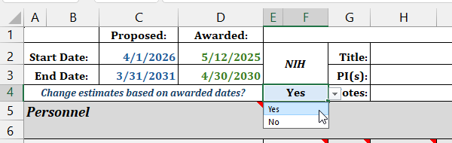
NEW OR Budget Template Features
OR Budget Templates are updated to with current rates and with a few additional features to assist you with budgeting

Slide 8
THANK YOU!
Thank you for partnering with Sponsored Programs!
Reach out to us at anytime with questions, comments or concerns:
Alyssa Bunn: aabunn@ucdavis.edu
Chris Dye-Hixenbaugh: cddye@ucdavis.edu
proposals@ucdavis.edu
awards@ucdavis.edu
subawards@ucdavis.edu

