Slide 1
SPO Awards
October 26, 2022

Slide 2
ATF PI Exception
The rules for PI exception in the after-the-fact stage are the same as when you submit a proposal before receiving the award
only qualified members of the Academic Senate and appointees in other eligible title groups listed in the UC Academic Senate policy may submit proposals without the need for an exception
Appointees must be at 50% or more of full time to submit proposals without the need for an exception

Slide 3
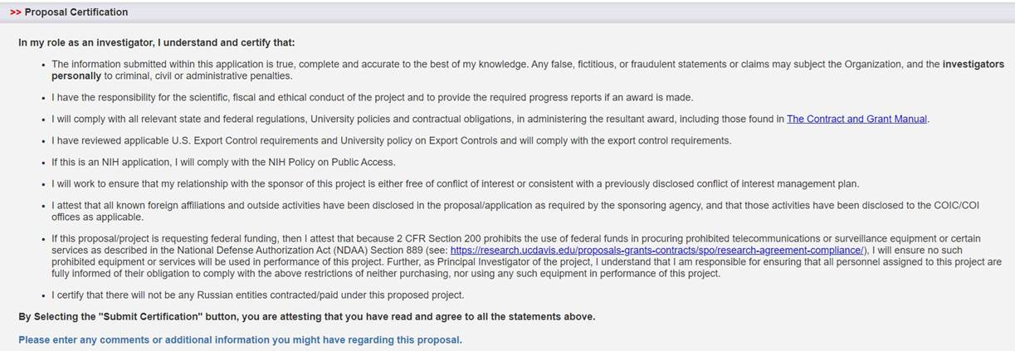
Russian sanctions added to PI certification in IPF
Very soon, the IPF certification will look like the below. See additional certification.

Slide 4
End of the year Prior Approval requests
If you have prior approval requests* for SPO to submit to the sponsor by the end of the year, please submit those requests to us early.
*Carryforward requests, Rebudget requests, or anything else

