Slide 1
Proposal & Award Team updates ________________ Research Forum October 2024

Slide 2
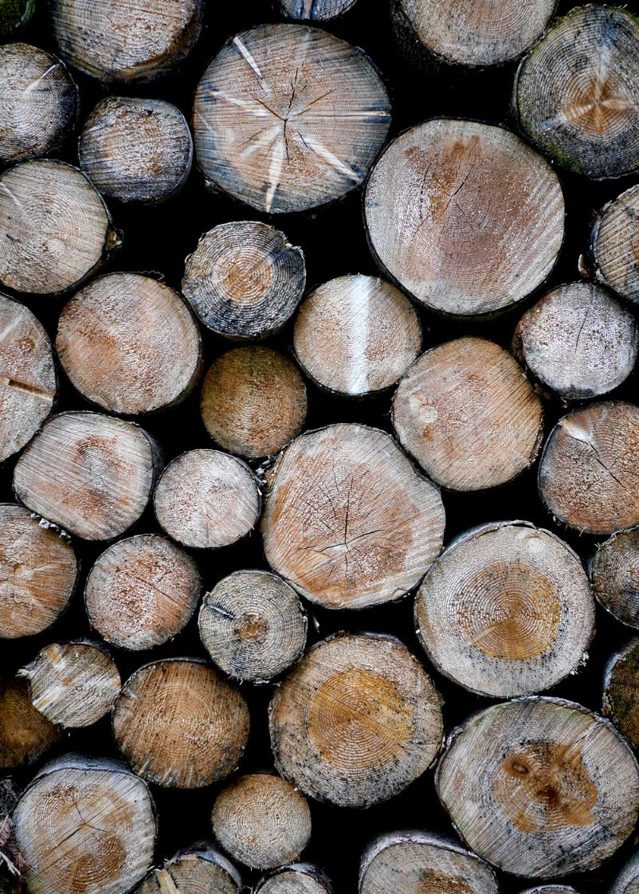
Agenda *Review of Application *Submission reminders *NSF Multi-Factor Auth (MFA) *Award reminders

Slide 3
Submission reminders
Review of Application
Take steps to provide Principal Investigators with view and print access to their pending applications, so they can ensure alignment with sponsor guidelines and their expectations of the overall package.
When submitting proposals on heavy submission deadlines, it is especially important that Principal Investigators and administrative departments review the final application package prior to submission.
Resubmitting a ”Changed/Corrected” application slows down the submission process during heavy deadlines due to sponsors’ system limitations.

Slide 4
NSF Multi-Factor Authentication (MFA) effective Sunday, October 27, 2024
NSF Multi-Factor Authentication (MFA) effective Sunday, October 27, 2024
https://www.nsf.gov/pubs/2025/nsf25011/nsf25011.jsp
As part of our ongoing commitment to enhancing security and safeguarding NSF's IT systems, user accounts, personal and scientific data, and the integrity of the merit review process, effective on Sunday, October 27, 2024, the U.S. National Science Foundation (NSF) is implementing multifactor authentication (MFA) for Research.gov.

Slide 5
Awards
Update on recruitments
Please email analysts directly when following up on award action statuses
Thank you for your patience during this time of reduced staffing

Slide 6
Thank you!!!
Proposals Team: proposals@ucdavis.edu
Alyssa Bunn
aabunn@ucdavis.edu; 530-754-7996
Chris Dye-Hixenbaugh
cddye@ucdavis.edu; 530-754-8034
Awards Team: awards@ucdavis.edu
Brooke Curry
bcurry@ucdavis.edu; 530-754-8143
See you in January 2025!

