Slide 1
Research Administration Forum
January 2024

Slide 2
AGENDA
Form 800s – NASA
IPF Reminders
NSF PAPPG Update
Update to Subaward Invoicing
Q&A

Slide 3
FORM 800s - NASA
Per revised UCOP policy, effective December 1, 2023, SPO is required to collect Form 800s at the proposal stage for NASA submissions, just as we do for NSF submissions.
Source: https://policy.ucop.edu/doc/2500633/NSF-NASA_COIDisclosure

Slide 4
IPF REMINDERS
Subaward SOWs
Detailed SOWs
Internal Excel Budget
Please attach a separate scope of work for each proposed subaward. It can be difficult to parse out duties when the scopes of multiple subs are combined. Additionally, SPO needs to review each on an individual basis and with a clear understanding of the scope of the sub’s proposed work.
Please provide a detailed scope of work , not only for the work UC Davis proposes to complete, but also for each proposed subawardee. SPO needs to clearly understand the work to be completed to ensure that the correct F&A rate is applied to UC Davis work and the work subs complete are properly classified as either a subaward or a subcontract.
Please always provide SPO with a detailed internal Excel budget; SPO uses detailed internal budgets to verify effort, fringe benefit rates, allowable and allocable costs, and correct calculation of indirect cost rates.
Budget templates are available on SPO’s website at https://research.ucdavis.edu/proposals-grants-contracts/spo/spo-proposal/#prep.

Slide 5
NSF PAPPG UPDATE
NSF’s Proposal & Award Policies & Procedures Guide (PAPPG) has been updated as of 1/22/24 and is effective for proposals submitted or due on or after May 20, 2024.
https://new.nsf.gov/policies/pappg/24-1

Slide 6
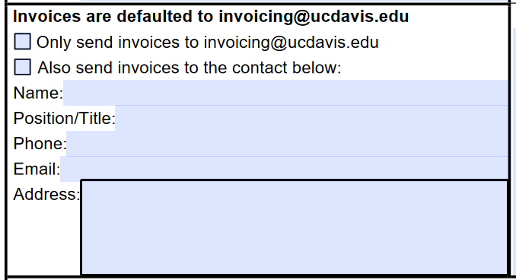
Update to Subawards Invoicing
With the go-live of Aggie Enterprise, we’ve updated the invoicing section of the Subaward Request Form to allow for copies of invoices to be directed to a designed individual as follows:

Slide 7
Questions?
7

Slide 8
THANK YOU
Kelly Gilmore
kngilmore@ucdavis.edu

