Slide 1
RCR Updates
Alaisha Hellman, Director RECO
August 27, 2025

Slide 2
Responsible Conduct of Research Updates
Recent Responsible Conduct of Research (RCR) updates emphasize expanded training requirements from federal agencies like the NSF and NIH, now including faculty and senior personnel. Key updates include the inclusion of mentor training and mentorship in training programs, as well as new regulations for research security training mandated by the CHIPS Act.

Slide 3
Responsible Conduct of Research
NSF (New) Requirements
July 31, 2023

Slide 4
NSF (New) RECR Requirements
The requirement specified in Section 7009 of the America COMPETES Act (42 USC 1862o–1), as amended, to have a plan to provide appropriate training and oversight in the responsible and ethical conduct of research (RECR) to faculty and other senior personnel who will be supported by NSF to conduct research will go into effect… July 31, 2023.
Institutional Responsibilities
An institution must have a plan in place to provide appropriate training and oversight in the responsible and ethical conduct of research to undergraduate students, graduate students, postdoctoral researchers, faculty, and other senior personnel who will be supported by NSF to conduct research. As noted in Chapter II.D.1.d(iv), an institutional certification to this effect is required for each proposal.
Institutions are responsible for verifying that undergraduate students, graduate students, postdoctoral researchers, faculty, and other senior personnel supported by NSF to conduct research have received training in the responsible and ethical conduct of research.

Slide 5
NSF RCR Requirements
From Title 42-THE PUBLIC HEALTH AND WELFARE, CHAPTER 16-NATIONAL SCIENCE FOUNDATION
42 USC §1862o–1. Responsible conduct of research
The Director shall require that each institution that applies for financial assistance from the Foundation for science and engineering research or education describe in its grant proposal a plan to provide appropriate training and oversight in the responsible and ethical conduct of research to undergraduate students, graduate students, postdoctoral researchers, faculty, and other senior personnel participating in the proposed research project, including-
(1) mentor training and mentorship;
(2) training to raise awareness of potential research security threats; and
(3) Federal export control, disclosure, and reporting requirements.
Section was enacted as part of the America COMPETES Act, also known as the America Creating Opportunities to Meaningfully Promote Excellence in Technology, Education, and Science Act, and not as part of the National Science Foundation Act of 1950 which comprises this chapter.
https://www.nsf.gov/policies/pappg/23-1/ch-9-recipient-standards#b-responsible-and-ethical-conduct-of-research-recr-9c7

Slide 6
Effective July 31, 2023
The Director shall require that each institution that applies for financial assistance from the Foundation for science and engineering research or education describe in its grant proposal a plan to provide appropriate training and oversight in the responsible and ethical conduct of research to undergraduate students, graduate students, postdoctoral researchers, faculty, and other senior personnel participating in the proposed research project, including-
(1) mentor training and mentorship;
(2) training to raise awareness of potential research security threats; and
(3) Federal export control, disclosure, and reporting requirements.

Slide 7
Impact of changes…
The required RCR training is now applicable to anyone funded by NSF on or after July 31, 2023.

Slide 8
How does RECO determine who must take this training?
Anyone who has received any payroll payment from an NSF award, is on our list.
Concerns: Mistakes made in assigning funding incorrectly

Slide 9
How can we help?
Talk to department payroll please.
Ensure they are aware that any mistakes made in assigning funding incorrectly, could lead to someone taking up to 4-5 hours of training.

Slide 10
NIH Training Requirements
NIH implementing a new Research Security Training

Slide 11
NIH new Requirements
The National Institutes of Health (NIH) has issued NOT-OD-25-133, outlining a new research security training requirement for all Senior/Key Personnel on funded proposals and awards, requiring completion within one year of proposal submission to ensure proper disclosure of other research support activities.
This includes the requirement to disclose all research activities and affiliations (active and pending) in Other Support (see Other Support Form). These changes impact all NIH-funded proposals and awards and are effective October 1, 2025.

Slide 12
NIH upcoming Requirements
(NOT-OD-25-133): Effective October 1, 2025, NIH requires the following:
Recipients must provide training to all faculty and researchers identified as Senior/Key Personnel on the requirement to disclose all research activities and affiliations (active and pending) in Other Support (see Other Support form) to ensure Senior/Key Personnel fully understand their responsibility to disclose all resources made available to the researcher in support of and/or related to all of their research endeavors, regardless of whether or not they have a monetary value and regardless of whether they are based at the institution the researcher identifies for the current grant.

Slide 13
NIH upcoming Requirements
The U.S. National Science Foundation, in partnership with the National Institutes of Health, the Department of Energy and the Department of Defense, has developed an online research security training for the research community. Institutions may use this training to assist in fulfilling the other support training requirement; however, institutions must also train on NIH-specific requirements per the NIH Grants Policy Statement (GPS), Section 2.5.1 "Just-in-Time Procedures", and any institution-specific requirements per the institution’s other support policy.

Slide 14
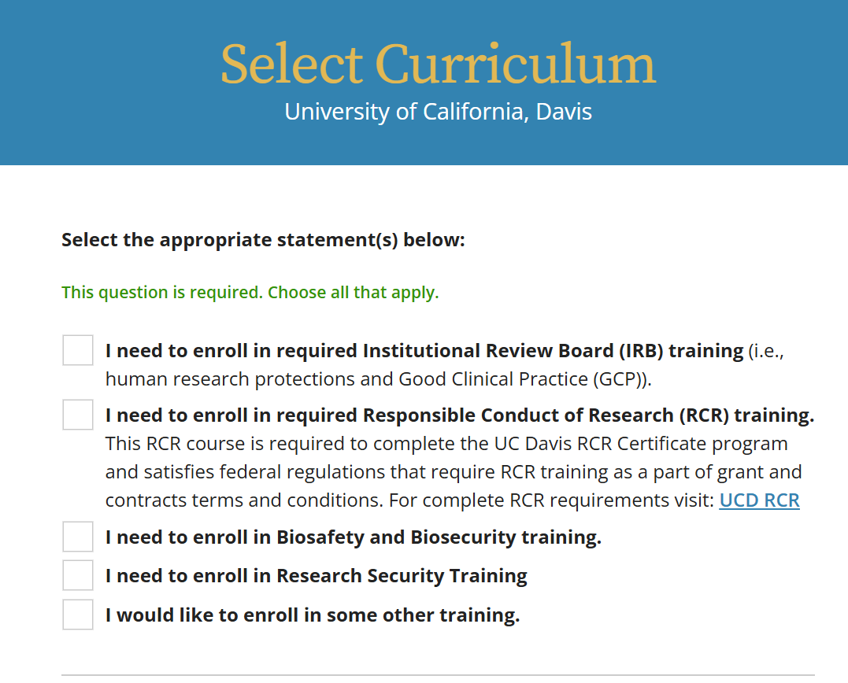
Training in CITI

Slide 15
NIH New Requirement
How does RECO determine who must take this training?
Likely, from payroll data!

Slide 16

Questions?
Alaisha Hellman
RECO Director
amhellman@ucdavis.edu

