Slide 1
Research Administration Forum
May 2024

Slide 2




Updates
Proposals
Subawards
Awards

Slide 3


Proposals
NIH Submissions

Slide 4



NIH Submissions
For NIH submissions, including supplemental requests, please use Cayuse 424 because it provides a more user-friendly structure, clear instructions and swift validation. ASSIST submissions typically take a bit longer, please allow extra time for submission.

Slide 5

Subawards

Slide 6
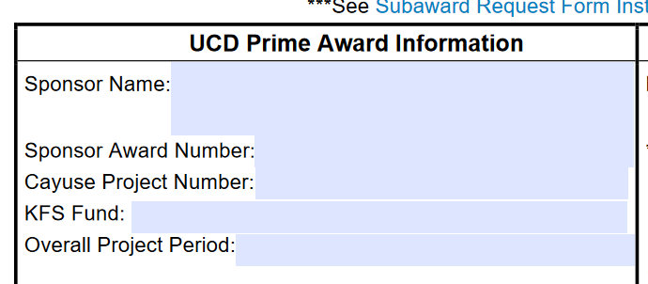
Subaward Request Form
On the Subaward Request Form, please be sure to provide the accounting fund number in the “KFS Fund” field. We have updated the form field that’s on our website to reflect “Accounting Fund Number” to clarify the intent, but wanted to let those of you know who may be working off a saved copy.

Slide 7

Awards

Slide 8
RPPRs and Fiscal Year-End
For reports that previously listed Grace’s name as the AOR, please list Bea Rans Strong.
Fiscal year-end is quickly approaching. Please be sure to submit any agreements and amendments that require execution prior to June 30th as soon as possible.

Slide 9


Thank you
kngilmore@ucdavis.edu
proposals@ucdavis.edu
subawards@ucdavis.edu
awards@ucdavis.edu
Research administration forum

