Slide 1
UC Davis Data Classification Seminar Series
April 2025
Factors for and outcomes of data classification for research

Slide 2
Factors
Actual data elements
Data elements associated with the data
Source of the information
Classification of systems used
Agreements with security requirements
NDA or other confidentiality agreements
Location of subjects (i.e. GDPR)
Researcher’s perception of breach impact
Number of records for PII
Federal/State laws
Change in regulations, risk aversity, etc.

Slide 3
Use of VRA outcomes
Currently visible to Unit UISLs for all VRAs by ISO
VRA = Vendor Risk Assessment
Other risk assessments also may apply
Old rating – protection provided by supplier
New rating – estimated risk for P1 – P4
VRAs are use case specific
VRA outcome for other use cases may not apply
Confidence rating for risk suggests accuracy
For P4, VRA & therefore classification annually
For P3, every two years
Good progress toward broader view of outcomes

Slide 4
Collaboration
UISL
IRB
Privacy
Counsel
Procurement
ISO

Slide 5
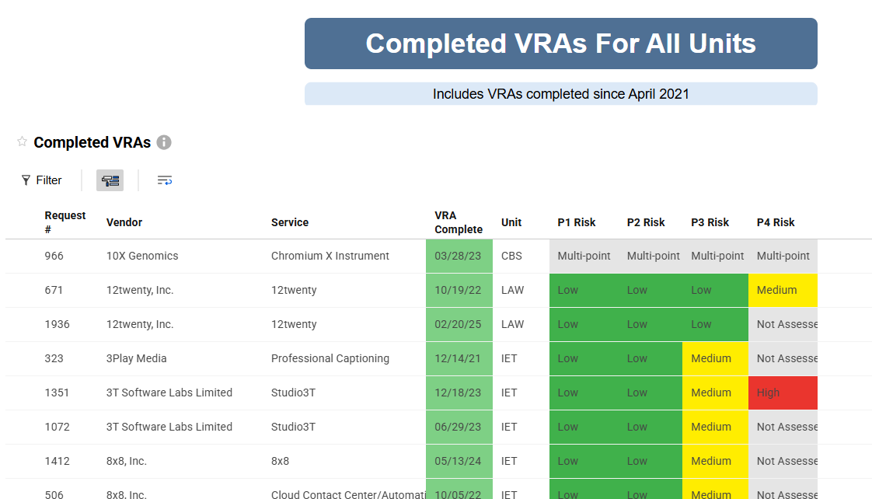
Demonstration

